Slide 1

Pitch Smurf
Andrew Mo
Aditya Singhal

Slide 2
Architecture
Built with Python and Native WebStack
The Flask backend serves the main connection point where the user inputs the company name
Company is converted to a ticker symbol using Marketdata API
Ticker symbol is used to access financial and other information about the company
We provide distinctive price analysis values based on TTM data
Also provide Social Media Engagement data points (Not just number of followers)
All of this data is presented as a PowerPoint.
Demo: http://127.0.0.1:5000/

Slide 3
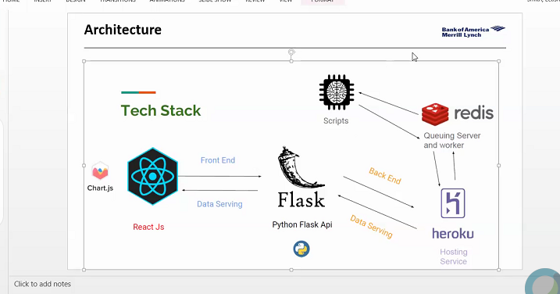
Slide to answer questions about financial modeling. Xnot slide just presentation point and then talk about it, especially how you get data quickly
Flow map
- Flask App > ui > input company > post request > scrape data
Presentation total is 7 min

